Slide 1

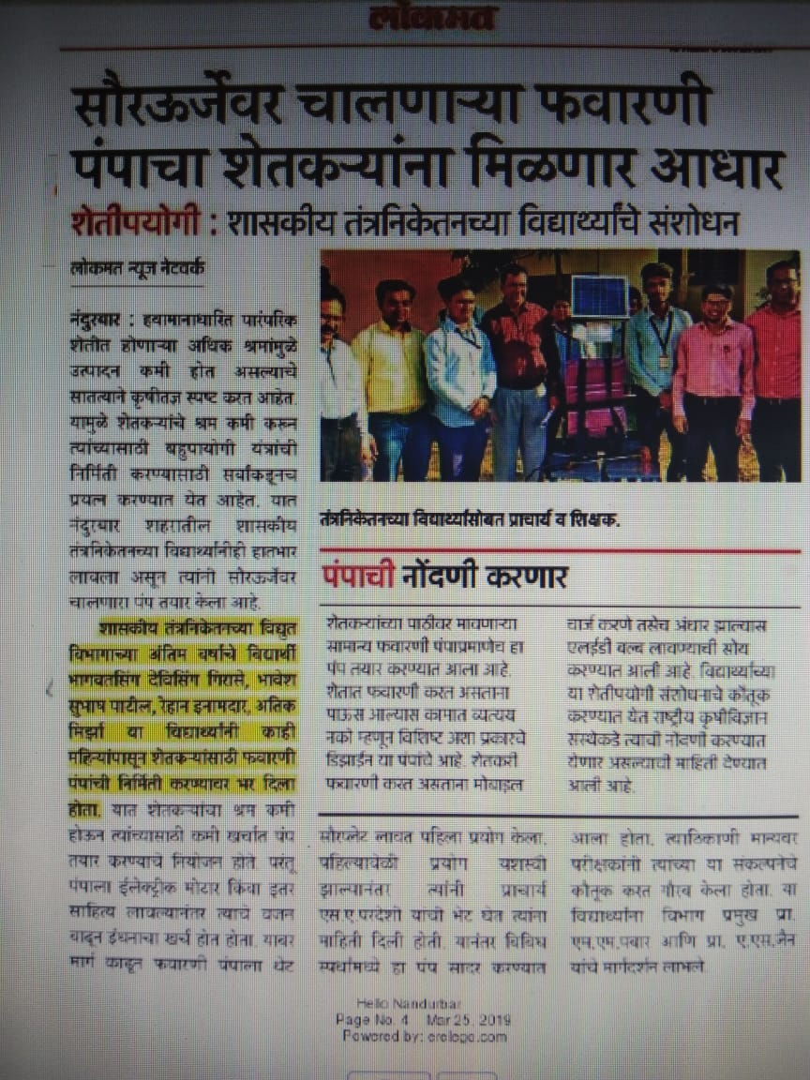
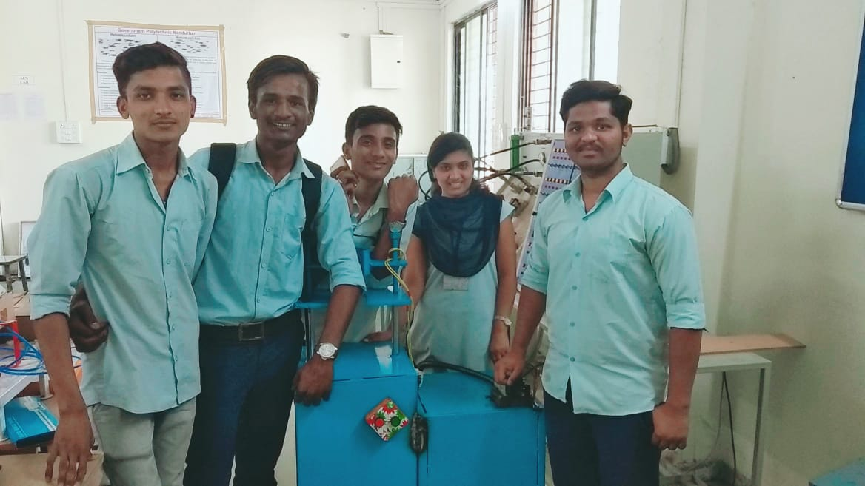
Innovative Projects
Hyd. Operated hose fitting Machine by ME6I

Slide 2
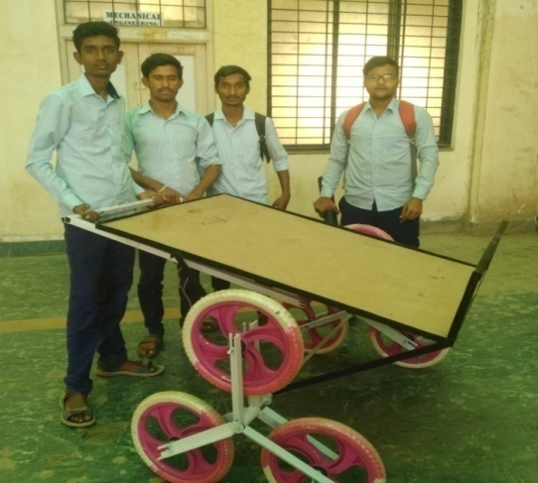
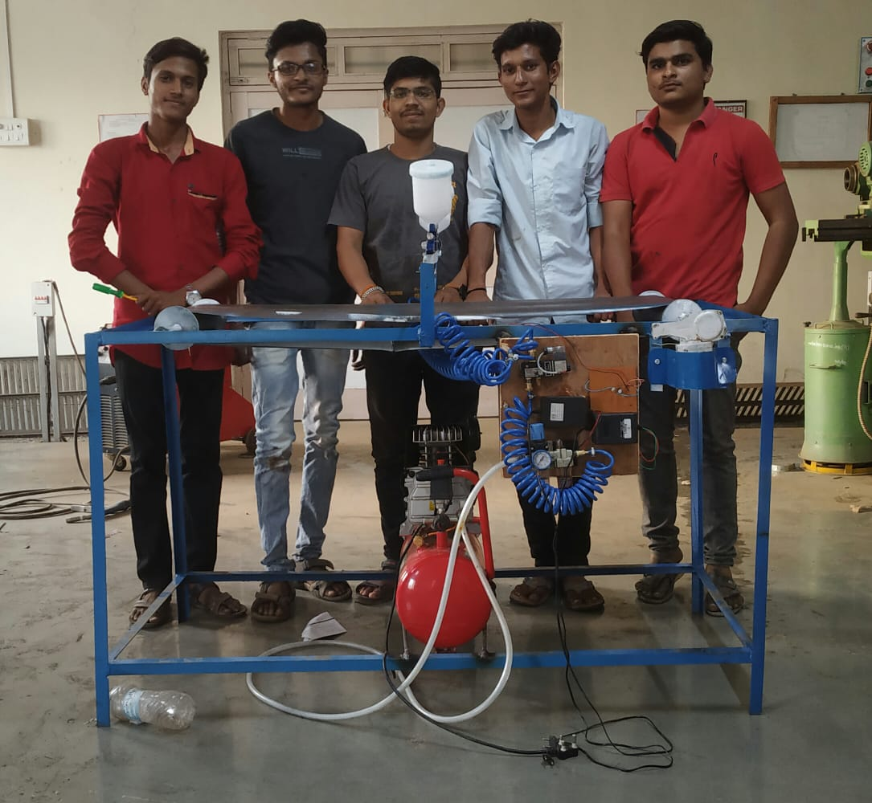
Innovative Projects
Automatic Spray Painting Machine by ME6I
Staircase Trolley by ME6G

Slide 3
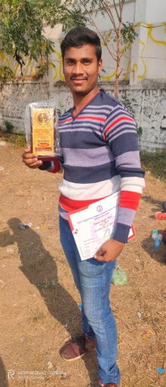
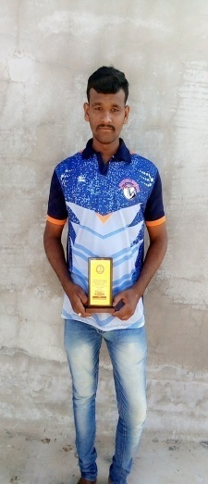
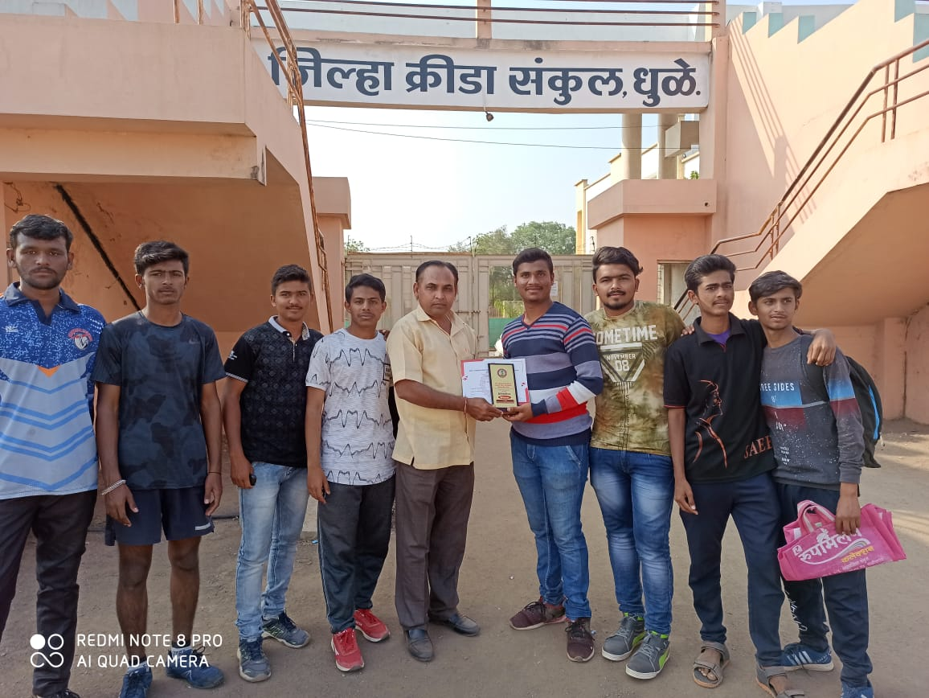
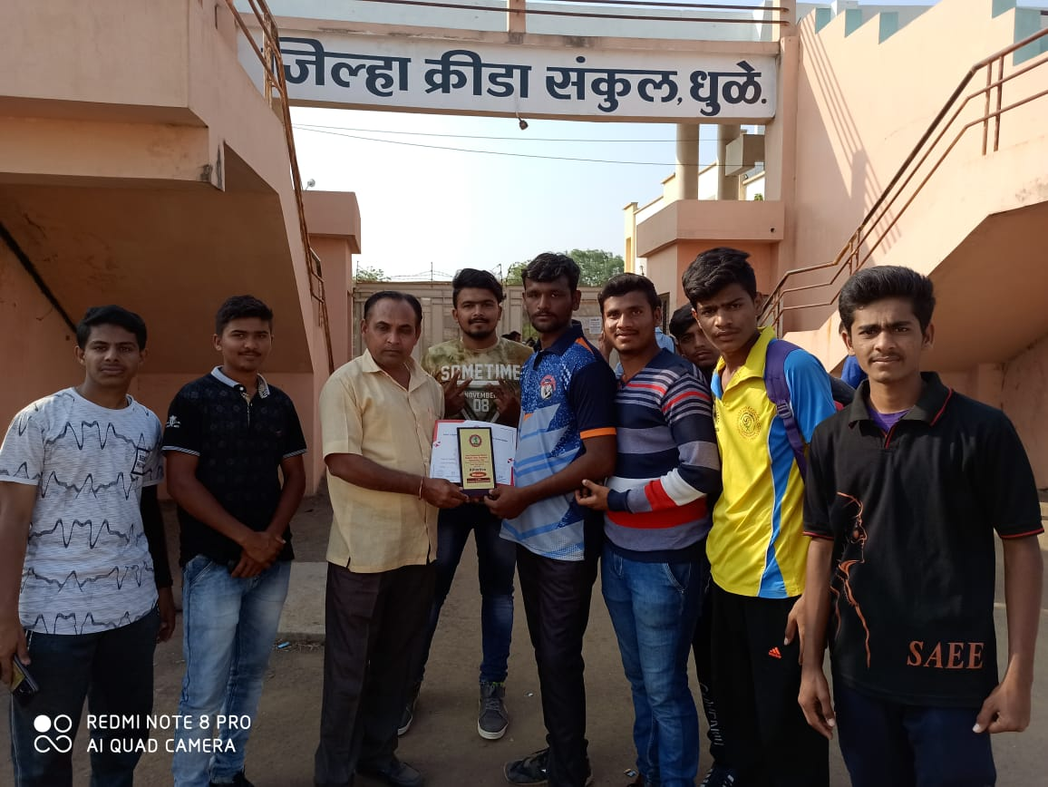
IEDSSA Zonal Sports
SACHIN KISHOR BADGUJAR,
2314320061, ME4I
Shotput Winner,
Selected for State level.
SUBODH ISHWAR PATIL,
2214320055, EE6I
Discuss Throw Runner up

Slide 4
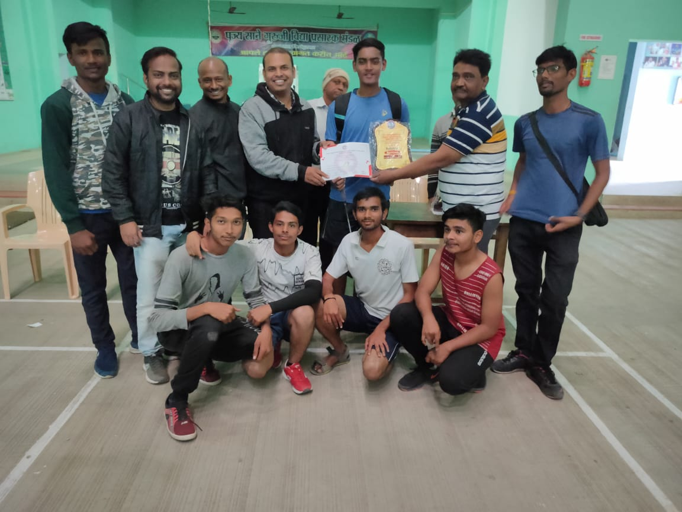
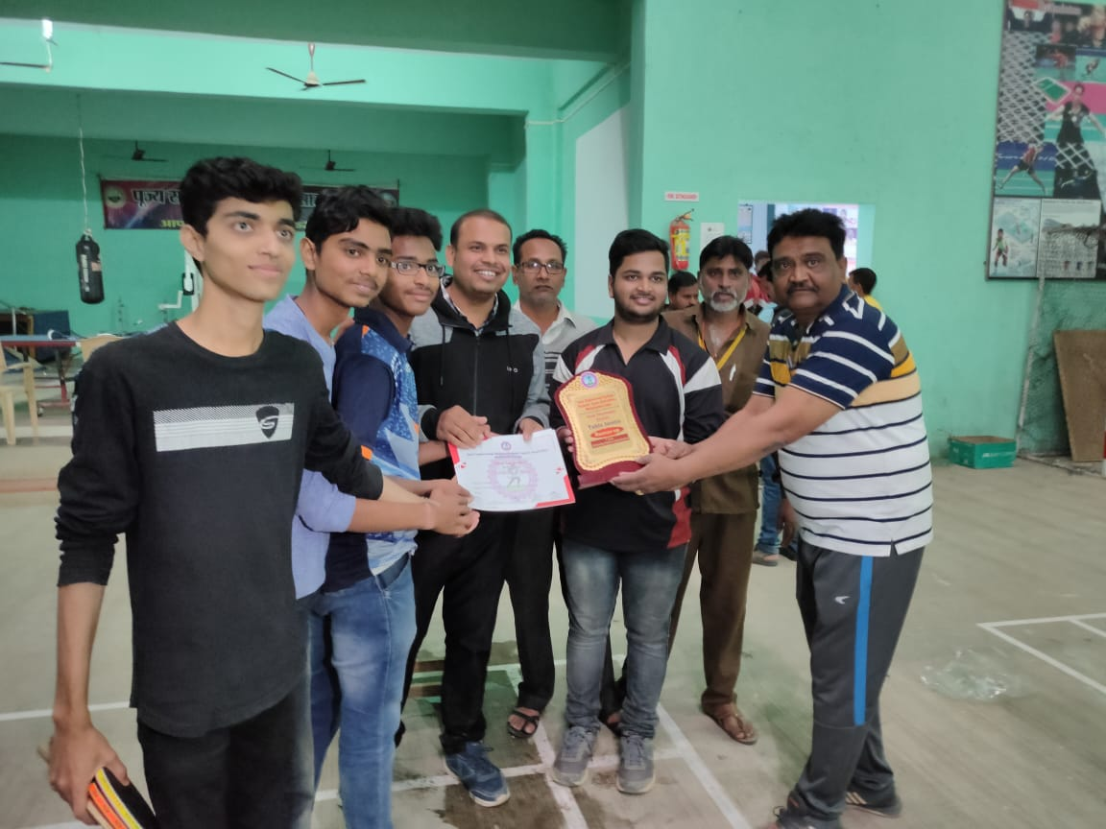
IEDSSA F Zone Sports
PATIL BHAVESH JAGDISH
PATIL AAYUSH SAMIR,
BHARAMBE DHAWAL GIRDHAR
KHAIRE RUSHIKESH BHAUSAHEB
NERKAR KAUSHAL SHARAD
Badminton Runner up’s
SONAR ABHISHEK RAJESH
CHAUDHARI KUNDAN YASHWANT
JEJURKAR DARSHAN PRASAD
SHIRSATH HRITIK RAKESH
NERKAR KAUSHAL SHARAD
Table Tennis Runner up’s

Slide 5
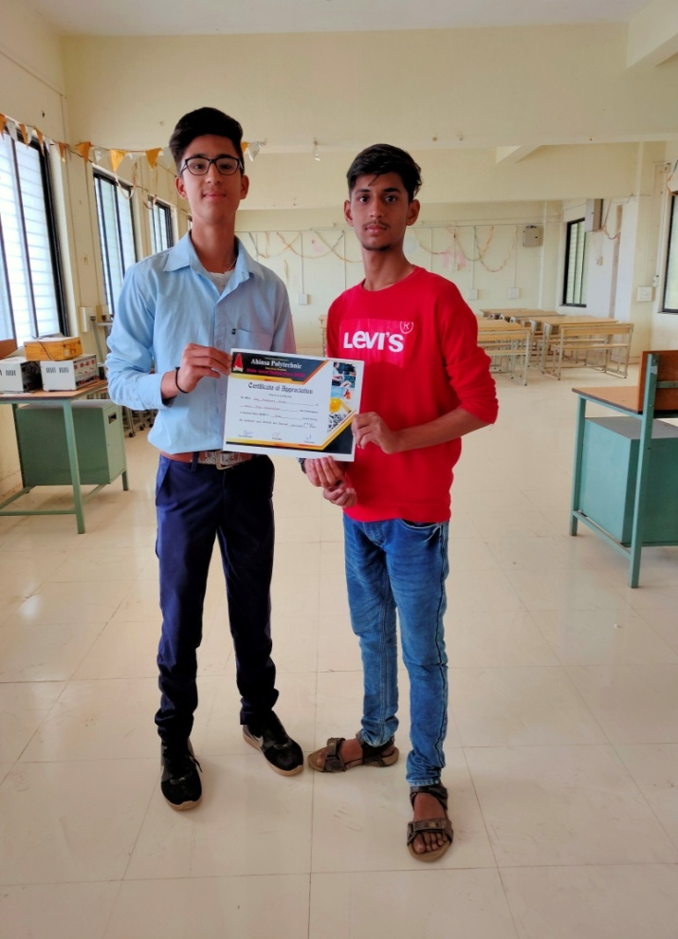
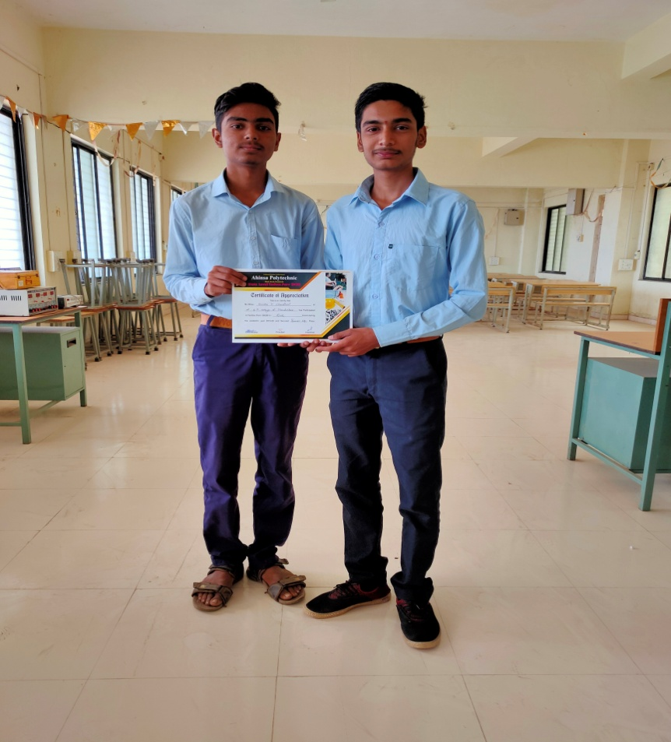
State Level Quiz Competition
JAY SONAR,ATHARV YEOLE (EE2K)
Winner,
State Level Quiz Competition,
Ahinsa Polytechnic ,Dondaicha
PRATHMESH CHAUDHARI, KUNDAN CHAUDHARI (CO4K)
Runner Up,
State Level Quiz Competition,
Ahinsa Polytechnic ,Dondaicha

Slide 6
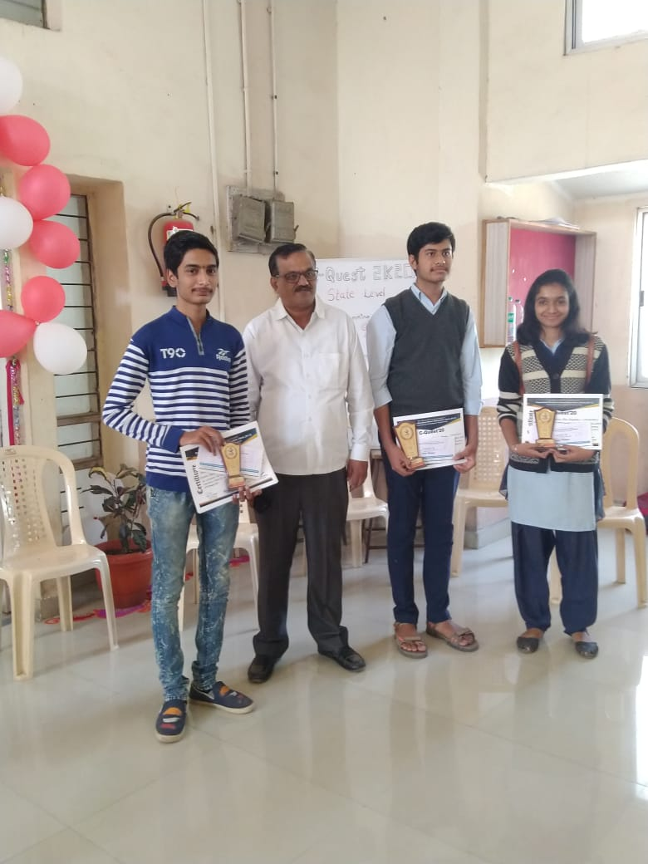
State Level C Language Quiz Competition
PRATHMESH CHAUDHARI, (CO4K)
IInd Runner Up,
State Level C Language Quiz Competition,,S S V P S Poly Dhule

Slide 7
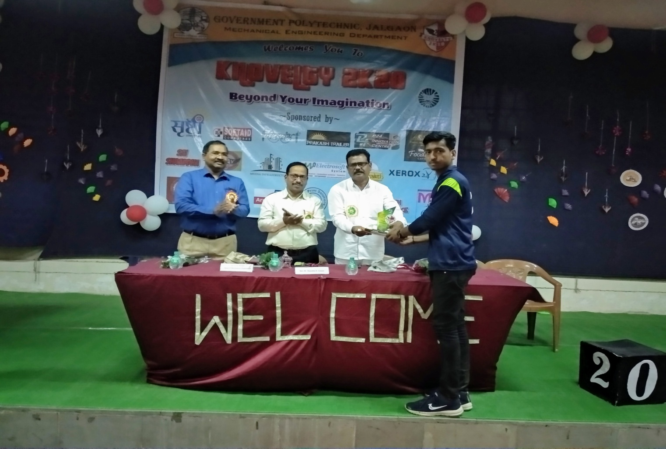
State Level AUTO CAD Competition
KHEMCHAND MAHAJAN, (ME6I)
WINNER,
State Level AUTO CAD Competition,,G P Jalgaon

Slide 8
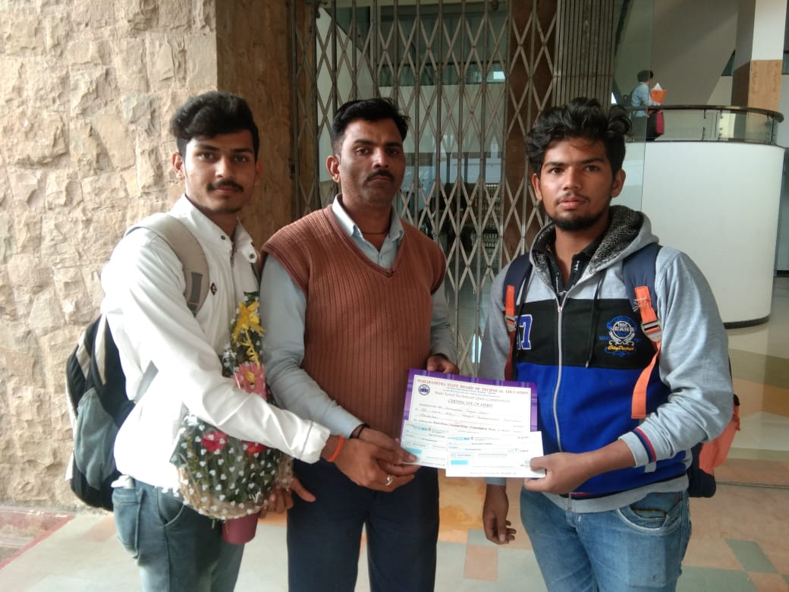
SHIVAM Tambatkar and Sagar Sonawane won 2 nd prize of Rs 10000 in State level quiz compitation held at Sandeep polytechnic, Nashik

